Slide 1
Sensitivity Analysis in R
Introduction to Decision Modeling Using R

Slide 2
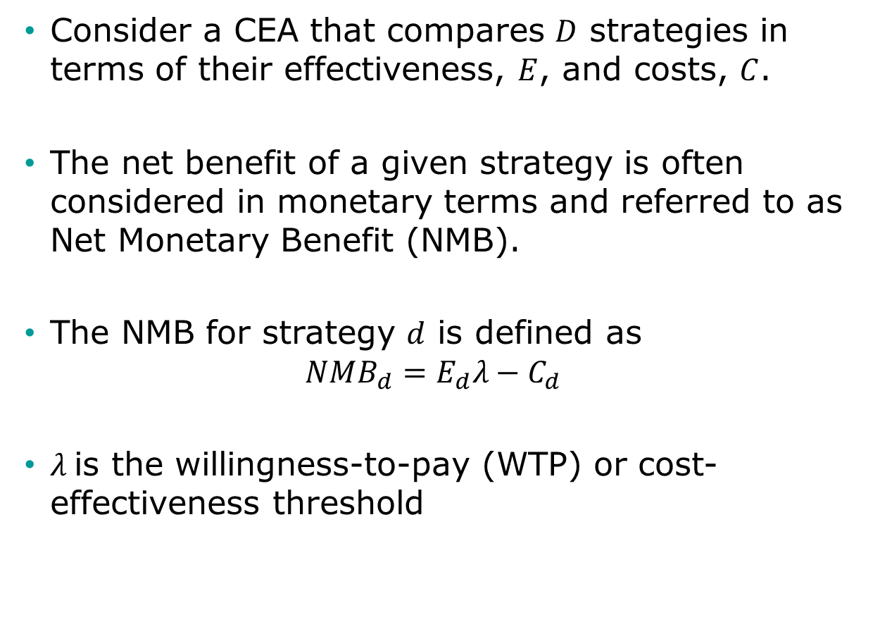
Brief note on CEA
Consider a CEA that compares $D$ strategies in terms of their effectiveness, $E$, and costs, $C$.
The net benefit of a given strategy is often considered in monetary terms and referred to as Net Monetary Benefit (NMB).
The NMB for strategy $d$ is defined as
$$NMB_{d}=E_{d}λ−C_{d}$$
$λ$ is the willingness-to-pay (WTP) or cost-effectiveness threshold

Slide 3
Sensitivity Analysis
What is the optimal strategy across a plausible range of input parameter?
Deterministic sensitivity analysis (DSA)
One-way analysis: vary one parameter, hold rest fixed
Two-way analysis: vary two parameters, hold rest fixed
What is the uncertainty around the CEA outcomes ?
Probabilistic sensitivity analysis (PSA)
Simultaneously vary input parameters by randomly sampling from appropriate probability distributions
How often is each alternative cost-effective?
What strategy has the highest expected net benefit
What is the optimal value of input parameter given λ?
Threshold Analysis

Slide 4
Probabilistic Sensitivity Analysis (PSA)

Slide 5
Probabilistic Sensitivity Analysis (PSA)
Inputs
Model
Outputs
x
1
Effect
x
NHB
2
Cost
x
i

Slide 6
Probabilistic Sensitivity Analysis (PSA)
p.HS
Healthy (H)
Sick (S)
p.HD
p.SD
Dead (D)

Slide 7
Probabilistic Sensitivity Analysis (PSA)
p.HS
Healthy (H)
Sick (S)
p.HD
p.SD
Dead (D)

Slide 8
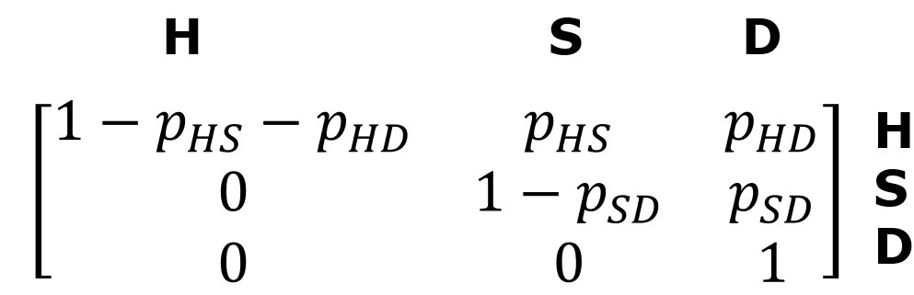
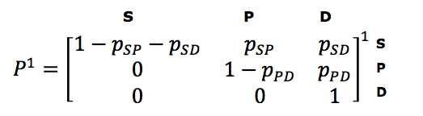
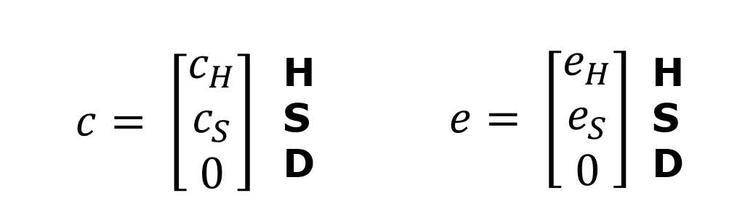
Matrix Implementation of the Markov Model
Transition probability matrix
Vector of cycle’s cost/outcomes
1
1
1
1
1
Notes:
Who is familiar with basic matrix calculations?
-> Inner product

Slide 9

Calculating total costs & effects
E = M e
TE = ι_{T} E
Total effects (TE):
Total costs (TC):
Net Monetary Benefit (NMB):
1
1
1
1
1
C =M c
TC = ι_{T} C
1
1
1
1
1
$${NMB}^{1}=TE^{1}λ−TC^{1}$$
ι_{T} : 1 × T vector of ones
$λ$: Willingness-to-pay or cost-effectiveness threshold

Slide 10
Presenting the PSA results
TC
. (TE¹, TC¹)
0
TE

Slide 11
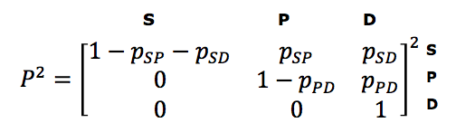
Matrix Implementation of the Markov Model
Transition probability matrix
Vector of cycle’s cost/outcomes
H S D
2
2
2
2
2
Notes:
Who is familiar with basic matrix calculations?
-> Inner product

Slide 12

Calculating total costs & effects
E =M e
TE = ι_{T} E
Total effects (TE):
Total costs (TC):
Net Monetary Benefit (NMB):
2
2
2
2
2
C =M c
TC = ι_{T} C
2
2
2
2
2
$${NMB}^{2}=TE^{2}λ−TC^{2}$$
ι_{T} : 1 × T vector of ones
$λ$: Willingness-to-pay or cost-effectiveness threshold

Slide 13
Presenting the PSA results
TC
. (TE², TC²)
. (TE¹, TC¹)
0
TE

Slide 14
Presenting the PSA results
TC
.
.
.
.
.
.
.
.
.
.
.
.
.
.
.
.
.
.
.
.
.
.
.
.
.
.
.
.
.
.
.
.
.
.
.
.
.
.
.
.
.
.
.
.
.
.
.
.
.
.
.
.
.
.
.
.
.
.
.
.
.
.
.
.
.
.
.
.
.
.
.
.
.
.
.
.
.
.
.
.
.
.
.
.
.
.
.
.
.
.
.
.
.
.
.
.
.
.
.
.
.
.
.
.
.
.
.
.
.
.
.
.
.
.
.
.
.
.
.
.
.
.
.
.
.
.
.
.
.
.
.
.
.
.
.
.
.
.
.
.
.
.
.
.
.
.
.
.
.
.
.
.
.
.
.
.
.
.
.
.
.
.
.
.
.
.
.
.
.
.
.
.
.
.
.
.
.
.
.
.
.
.
.
.
.
.
.
.
.
.
.
.
.
.
.
.
.
.
.
.
.
.
.
.
.
.
.
.
.
.
.
.
.
.
.
.
.
.
.
.
.
.
.
.
.
.
.
.
.
.
.
.
.
.
.
.
.
.
.
.
.
.
.
.
.
.
.
.
.
.
.
.
.
.
.
.
.
.
.
.
.
.
.
.
.
.
.
.
.
.
.
.
.
.
.
.
.
.
.
.
.
.
.
.
.
.
.
.
.
.
.
.
.
.
.
.
.
.
.
.
.
.
.
.
.
.
.
.
.
.
.
.
.
.
.
.
.
.
.
.
.
.
.
.
.
.
.
.
.
.
.
.
.
.
.
.
.
.
.
.
.
.
.
.
.
.
.
.
.
.
.
.
.
.
.
.
.
.
.
.
.
.
.
.
.
.
.
.
.
.
.
.
.
.
.
.
.
.
.
.
.
.
.
.
.
.
.
.
.
.
.
.
.
.
.
.
.
.
.
.
.
.
.
.
.
.
.
.
.
.
.
.
.
.
.
.
.
.
.
.
.
.
.
.
.
.
.
.
.
.
.
.
.
.
.
.
.
.
.
.
.
.
.
.
.
.
.
.
.
.
.
.
.
.
.
.
.
.
.
.
.
.
.
.
.
.
.
.
.
.
.
.
.
.
.
.
.
.
.
.
.
.
.
.
.
.
.
.
.
.
.
.
.
.
.
.
.
.
.
.
.
.
.
.
.
.
.
.
.
.
.
.
.
.
.
.
.
.
.
.
.
.
.
.
.
.
.
.
.
.
.
.
.
.
.
.
.
.
.
.
.
.
.
.
.
.
.
.
.
.
.
.
.
.
.
.
.
.
.
.
.
.
.
.
.
.
.
.
.
.
.
.
.
.
.
.
.
.
.
.
.
.
.
.
.
.
.
.
.
.
.
.
.
.
.
.
.
.
.
.
.
.
.
.
.
.
.
.
.
.
.
.
.
.
.
.
.
.
.
.
.
.
.
.
.
.
.
.
.
.
.
.
.
.
.
.
.
.
.
.
.
.
.
.
.
.
.
.
.
.
.
.
.
.
.
.
.
.
.
.
.
.
.
.
.
.
.
.
.
.
.
.
.
.
.
.
.
.
.
.
.
.
.
.
.
.
.
.
.
.
.
.
.
.
.
.
.
.
.
.
.
.
.
.
.
.
.
.
.
.
.
.
.
.
.
.
.
.
.
.
.
.
.
.
.
.
.
.
.
.
.
.
.
.
.
.
.
.
.
.
.
.
.
.
.
.
.
.
.
.
.
.
.
.
.
.
.
.
.
.
.
.
.
.
.
.
.
.
.
.
.
.
.
.
.
.
.
.
.
.
.
.
.
.
.
.
.
.
.
.
.
.
.
.
.
.
.
.
.
.
.
.
.
.
.
.
.
.
.
.
.
.
.
.
.
.
.
.
.
.
.
.
.
.
.
.
.
.
.
.
.
.
.
.
.
.
.
.
.
.
.
.
.
.
.
.
0
TE

Slide 15
Example of PSA dataset

Slide 16

Distributions
Distribution | Parameter modeled | Form | Comment
Uniform | Any | Range low-high | All values are equally likely. Uninformative distribution
Triangular | Any | Minimum, maximum, likeliest
Beta | Probability Quality of life weights (utility) | Beta (r,n): r = number of events and n = number of patients. For observed mean 𝜇 and standard error: | Bounded between 0 and 1
Dirichlet | Probability in the context of multiple events |  | Extension of the beta distribution, for multiple events
Hunink MGM, Weinstein MC, Wittenberg E, Drummond MF, Pliskin JS, Wong JB, Glasziou PP. Decision Making in Health and Medicine: Integrating Evidence and Values. Cambridge University Press, Cambridge, UK, 2014. ISBN 978-1-107-69047-9. Table 12.2, page 371
Notes:
Commonly used distribution to model parameter uncertainty

Slide 17

Distributions II
Distribution | Parameter modeled | Form | Comment
Lognormal | Rate Relative risk Hazard rate ratio Odds ratio Costs | ln(parameter) has a normal distribution with mean and standard error | Values >0, positively skewed
Gamma | Resource use Costs | Gamma (𝛼,𝛽) For observed mean 𝜇 and standard error s: | Values >0, positively skewed
Truncated |  |  | Restricting the domain of some other probability distribution
Histogram | Any | non-parametric | Based on trial data: observed relative frequency per value or per interval
Bootstrap | Any | non-parametric | Based on trial data: simulated relative frequency per value
Notes:
Hunink MGM, Weinstein MC, Wittenberg E, Drummond MF, Pliskin JS, Wong JB, Glasziou PP. Decision Making in Health and Medicine: Integrating Evidence and Values. Cambridge University Press, Cambridge, UK, 2014. ISBN 978-1-107-69047-9. Table 12.2, page 371

Slide 18
PSA in R
Common naming structure among (most) distributions in R
“q”+ dist. (e.g. qnorm()): quantile function
“d”+ dist.(e.g. dnorm()): density function
“p”+ dist.(e.g. pnorm()): c.d.f function
“r” + dist.(e.g. rnorm()): random number generating function
sample():Random number sampling with(out) replacement and weights (e.g. for bootstrapping)

Slide 19
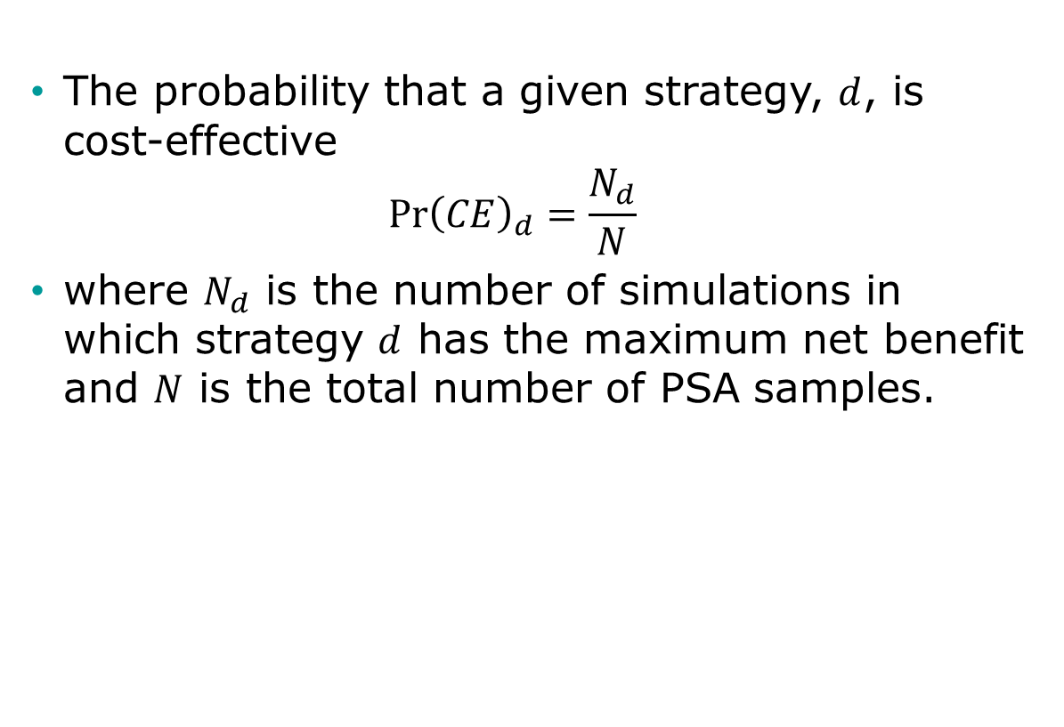
Decision Uncertainty
The probability that a given strategy, $d$, is cost-effective
$$\operatorname{Pr}{{\left(CE\right)}_{d}=\frac{N_{d}}{N}}$$
where $N_{d}$ is the number of simulations in which strategy $d$ has the maximum net benefit and $N$ is the total number of PSA samples.

Slide 20
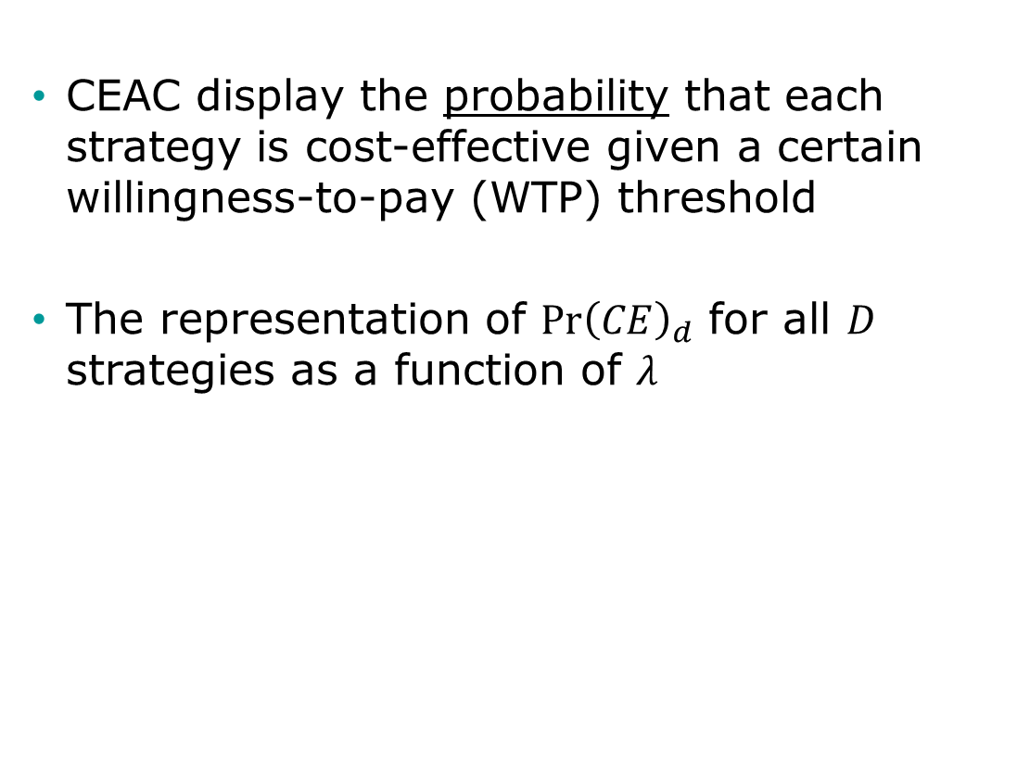
Cost-Effectiveness Acceptability Curves (CEAC)
CEAC display the probability that each strategy is cost-effective given a certain willingness-to-pay (WTP) threshold
The representation of $\operatorname{Pr}{{\left(CE\right)}_{d}}$ for all $D$ strategies as a function of $λ$

Slide 21
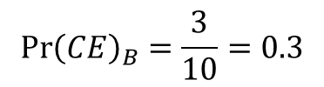

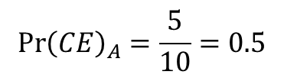



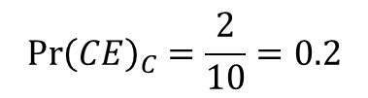
Construction of CEAC
$$N=10$$
$$N_{A}=5;$$
$$N_{B}=3;$$
$$N_{C}=2$$
$$\operatorname{Pr}{{\left(CE\right)}_{A}}=\frac{5}{10}=0.5$$
$$\operatorname{Pr}{{\left(CE\right)}_{B}}=\frac{3}{10}=0.3$$
$$\operatorname{Pr}{{\left(CE\right)}_{C}}=\frac{2}{10}=0.2$$
Highest probability

Slide 22
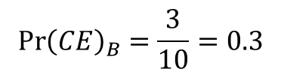

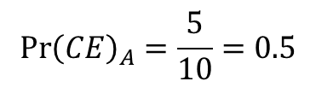



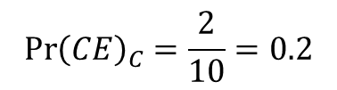
Construction of CEAC
$$N=10$$
$$N_{A}=5;$$
$$N_{B}=3;$$
$$N_{C}=2$$
$$\operatorname{Pr}{{\left(CE\right)}_{A}}=\frac{5}{10}=0.5$$
$$\operatorname{Pr}{{\left(CE\right)}_{B}}=\frac{3}{10}=0.3$$
$$\operatorname{Pr}{{\left(CE\right)}_{C}}=\frac{2}{10}=0.2$$
Highest probability

Slide 23
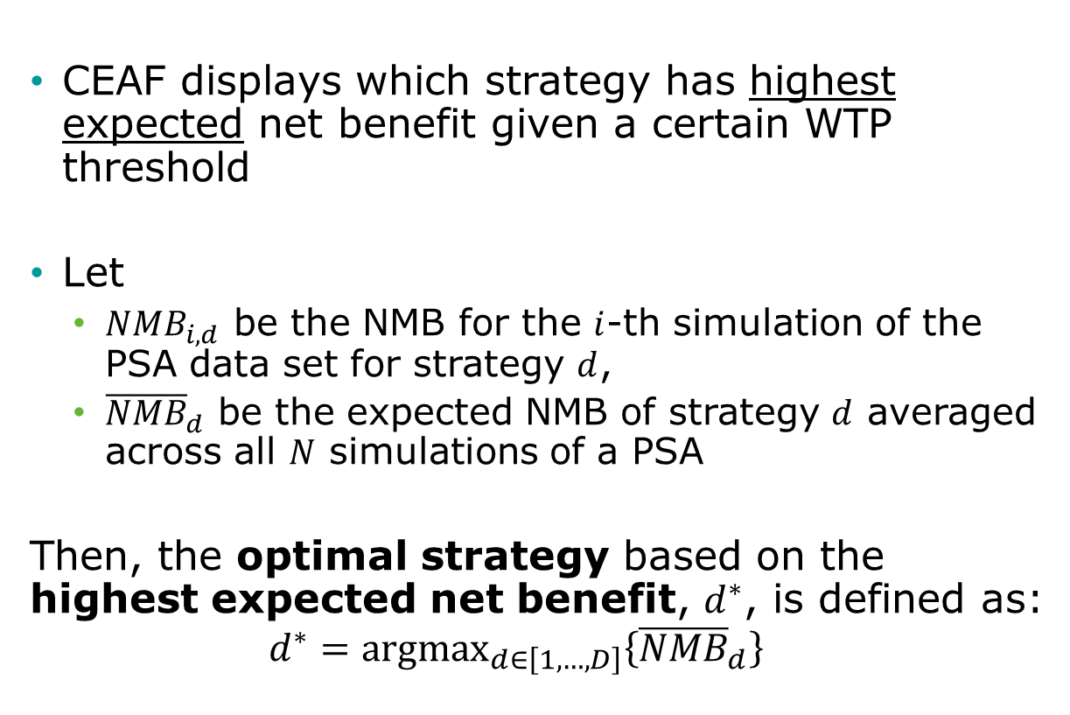
Cost-Effectiveness Acceptability Frontier (CEAF)
CEAF displays which strategy has highest expected net benefit given a certain WTP threshold
﻿Let
${NMB}_{i,d}$ be the NMB for the $i$-th simulation of the PSA data set for strategy $d$,
${\overline{NMB}}_{d}$ be the expected NMB of strategy $d$ averaged across all $N$ simulations of a PSA
Then, the optimal strategy based on the highest expected net benefit, $d^{∗}$, is defined as:
$$d^{∗}={\text{argmax}}_{d∈\left[1,…,D\right]}\left\{{\overline{NMB}}_{d}\right\}$$

Slide 24
Construction of CEAF
Highest expected net benefit = Optimal strategy

Slide 25
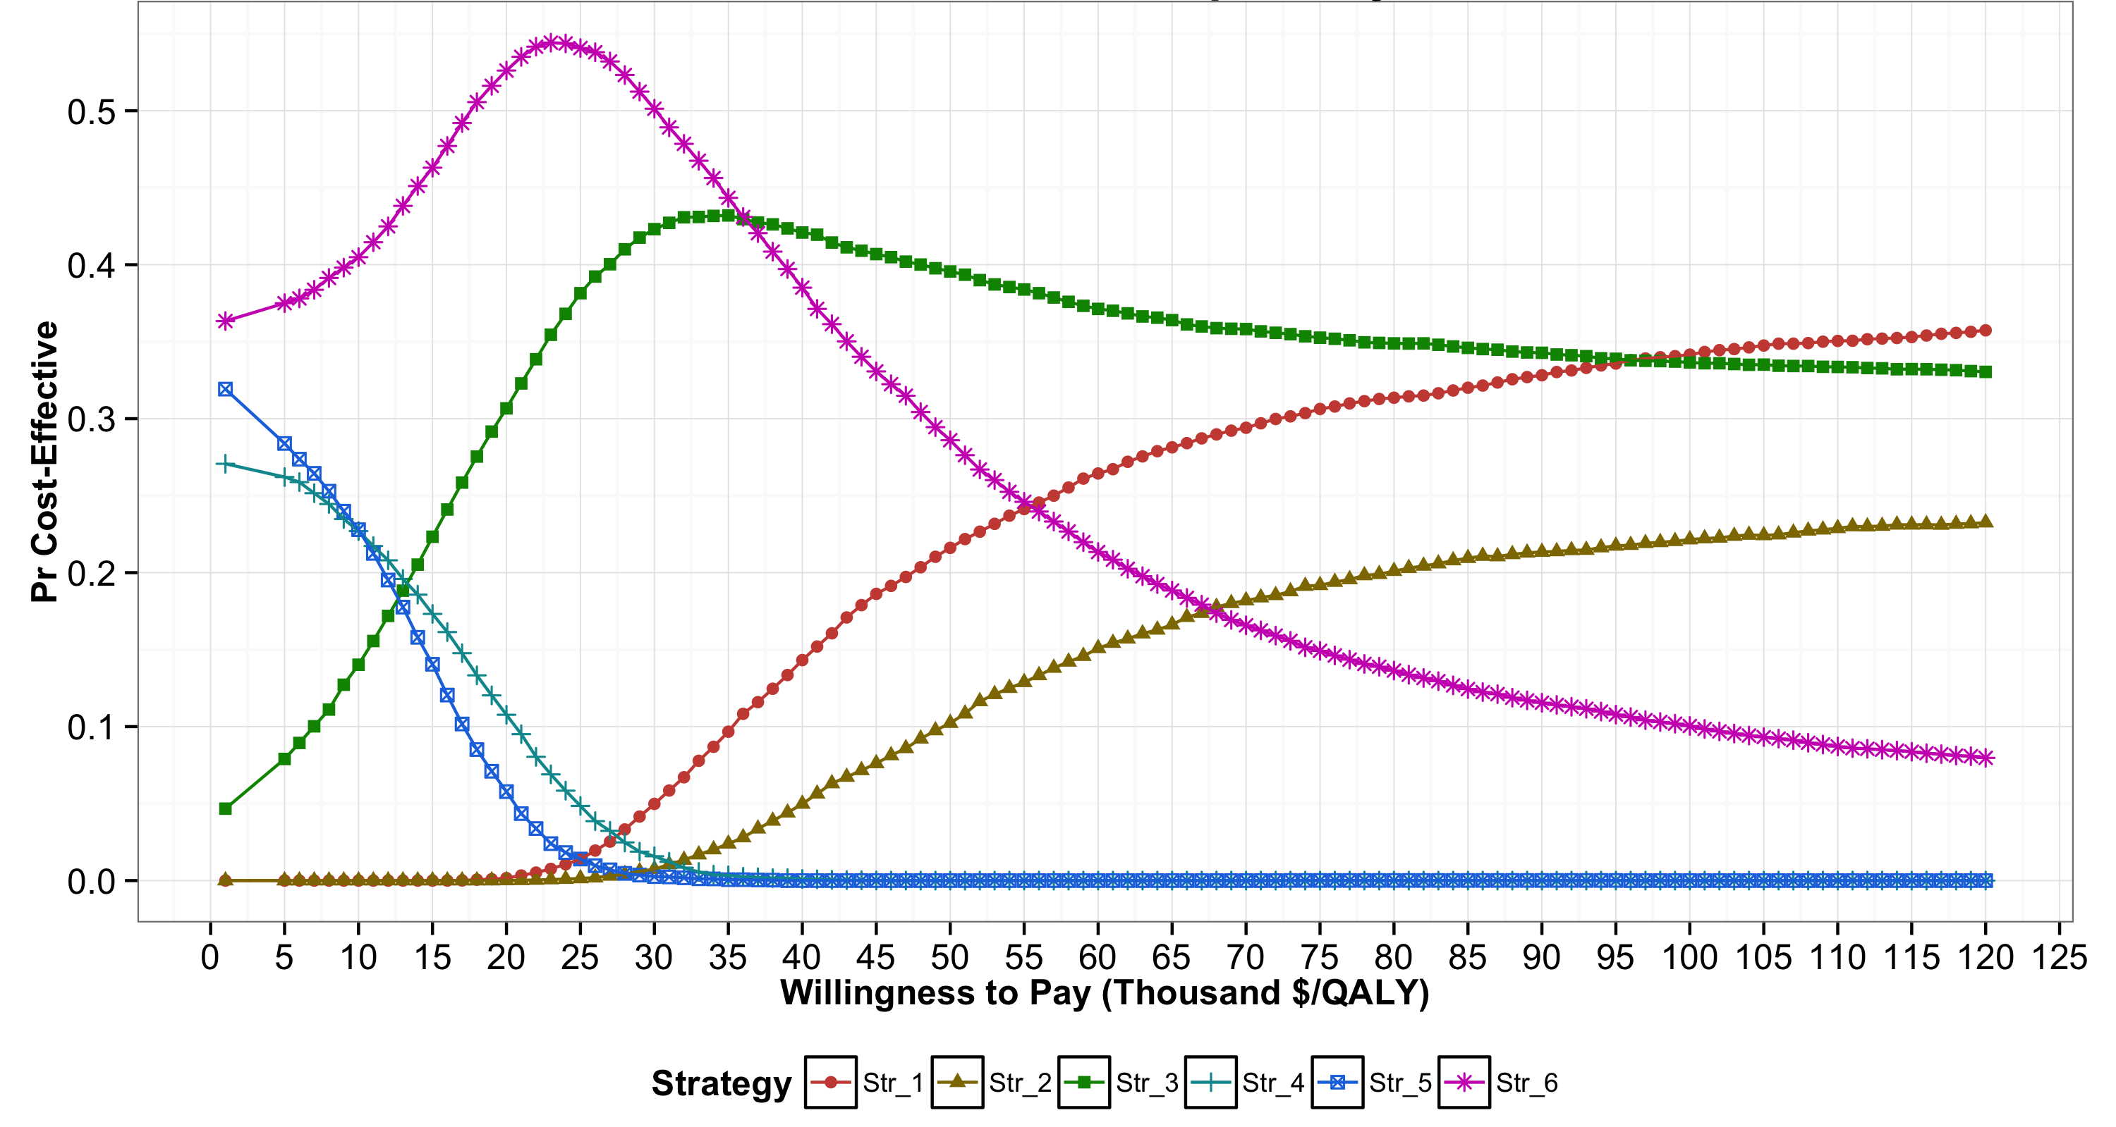
Cost-effectiveness acceptability curves (CEACs)

Slide 26
Cost-effectiveness acceptability curves (CEACs)

Slide 27
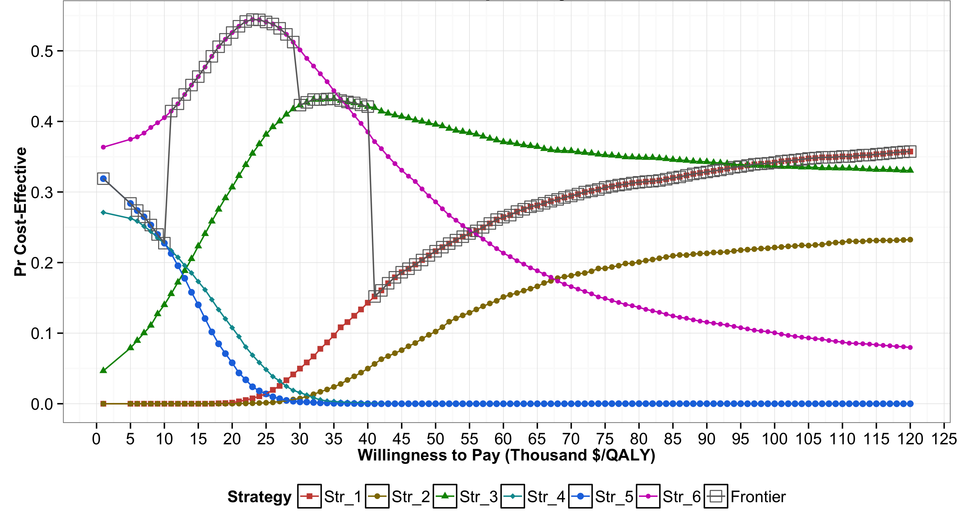
Cost-effectiveness acceptability curves (CEACs) and frontier (CEAF)

Slide 28
Cost-effectiveness acceptability curves (CEACs) and frontier (CEAF)

Slide 29
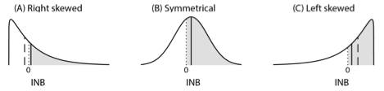
Distributions of Incremental NMB
Notes:
﻿The shaded area represents the probability of X being cost- effective compared to Y, which is the area under the curve to the right of INB = 0. The solid vertical line represents the expected INB of X vs. Y, and the dashed vertical line represents the median of the distribution of INB. X is optimal in all scenarios, but has the highest probability of being cost-effective only in scenarios B and C. In scenario B (i.e., symmetrical), the median and mean of INB coincide with each other.

Slide 30
Limitations of CEACs
Only provide certain level of comfort in a decision but do not influence decision making
Not actual influence on policy recommendation
Could be misleading -> ﻿the strategy that is most likely to be cost-effective should not be conflated with the strategy that is optimal in expectation in the decision-making process

Slide 31
Limitations of CEACs and CEAF
Neither ﻿capture the magnitude of the net benefit lost in the proportion of PSA samples when chosen strategy is not cost-effective
﻿The expected loss in net benefits is truly the concern of the decision-maker because this represents the foregone benefits resulting from having chosen a given strategy
﻿Do not communicate the ordinal information in the ranking of the strategies by their expected benefits
Useful when implementing the optimal strategy is not feasible.

